Slide 1
CIST 1300: Introduction to Web Development The Introduction to Intro to Web Development
Alexander Fuchsberger
afuchsberger@unomaha.edu
College of Information Science and Technology
http://www.ist.unomaha.edu/
University of Nebraska at Omaha
http://www.unomaha.edu/

Slide 2
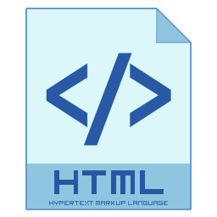
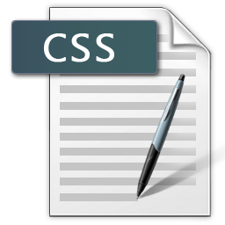

Course Overview
HTML
Create static web pages using HTML
CSS
Apply formatting and layout to those pages with CSS
JavaScript
Create programs using the JS programming language
Create static web pages combining all of the above

Slide 3
Internet vs. WWW
There is a subtle difference between what people refer to as the Internet and the World Wide Web.
The Internet is the hardware and low-level software protocol backbone that carries data from one place to another.
The hardware takes various forms, such as fiber-optic cable, wireless network cards, cable modems and routers.
The low-level software protocols are implemented directly in operating systems like Windows, Mac OS X or *nix (Unix and Linux). End users like us never see this software at work.

Slide 4
Internet vs. WWW
The World Wide Web is built upon hardware and software, also.
The hardware is a computer or other dedicated piece of hardware that will be a physical web server. This hardware will have a network card that connects it to the Internet. Additionally, there will be a computer, cel phone or other device that acts as a client.
On the physical web server, a piece of software also (confusingly) known as a web server will run on top of that machine's operating system.

Slide 5
Internet vs. WWW
The purpose of the software web server, such as Apache (http://httpd.apache.org/), is to behave like a file server, delivering requested content to clients.
A web browser such as Chrome, Firefox, Safari, Internet Explorer or Opera will run on the client computer. It will request information from the web server and render or otherwise process it when it receives a response from the server.

Slide 6

Web Server / Web Client
1
3
2
Web Browser Mozilla Firefox
(qbert.ist.unomaha.edu)‏
Web Server Apache 2.2.21
(blizzard.ist.unomaha.edu)‏
5
4
User interacts with browser, entering a URL directly, clicking on a link, etc.
A request is packaged up by the browser and sent via the network to the web server.
Web server receives and decodes request.
Web server retrieves requested information (a static HTML page), or finds that the requested information does not exist on the server; if configured to do so, server also logs request.
Server sends requested information, resource or error to browser.
Notes:
6

Slide 7
The Two-Slide History of the Internet / Web and Computers
1961 - 69 : Research into distributed networks
1969 : ARPANet (Advanced Research Projects Network) goes online with four sites on October 29th. The four sites are: UCLA, Stanford Research Institute, UC Santa Barbara and the University of Utah.
1972 : E-mail is invented. 23 sites are now online.
1974 : Vint Cerf and Bob Kahn coin the term "Internet".
1976 : 111 sites online.
1979 : USENET (news groups) created; still exists today (Google Groups).
1982 : Time magazine names "The Computer" as "Man of the Year". Also, first networked game: "Snipes"
1984 : William Gibson coins term "Cyberspace" in his book "Neuromancer"
1987 : Number of hosts reaches 10,000; Perl language released
1988 : Morris worm reaches 6,000 of the now 60,000 hosts. First worm.
1989 : Tim Berners-Lee introduces the concepts of hypertext that would lead to the development of HTML and the Web.
1990 : Berners-Lee creates first web server and browser.
1992 : Official "release" of the World Wide Web. 1,000,000 hosts.
1993 : First GUI web browser: NCSA Mosaic. HTML 1.1.

Slide 8
The Two-Slide History of the Internet / Web and Computers
1994 : First commercial browser: Netscape
1994 : Justin Hall believed to be one of first bloggers.
1995 : Internet Explorer released. Yahoo created on March 1st. HTML 2.0.
1996 : CSS 1.0
1997 : HTML 3.2 in January, HTML 4.0 in December.
1998 : Google created on September 7th. CSS 2.0. CSS 3.0 in 1999.
1999 – 02 : "Dotcom bubble” and subsequent crash
2000 : XHTML 1.0 released.
2003 : MySpace launched in August.
2004 : Facebook created on February 4th
2004 : "Web 2.0" term coined.
2005 : YouTube created on February 15th.
2006 : YouTube purchased for $1.65 billion. Twitter launched July 13th. Time’s Person of the Year: You!
2007 : iPhone on sale June 29th, 2007.
2008 : Google launches Chrome on 9/2, Android OS on 10/21. HTML5.
2009 : 3rd gen iPhone, Windows 7 and Palm Pre released
2010 /2011: 4th gen iPhone, Windows Phone, Android phones …
Notes:
8

Slide 9
Course Content: HTML
HTML5 is the current version of HyperText Markup Language.
HTML5 is a language that attempts to create a semantic meaning behind the data that you’re presenting.
For instance, in a word processor, you have the main body of your document as well as the header and footer that you can put persistent information in.
In HTML5, you surround the entire content of your web page inside the HTML5 tags <body> and </body>. You can also have a header, enclosed in the tags <header> and </header>, as well as a footer between <footer> and </footer>.
The language also lets you describe articles, sections, asides, citations, etc.

Slide 10
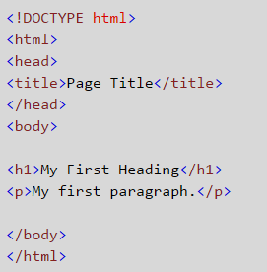
What is HTML?
HTML: HyperText Markup Language.
Creates a semantic meaning behind the data
HTML Tags

Slide 11
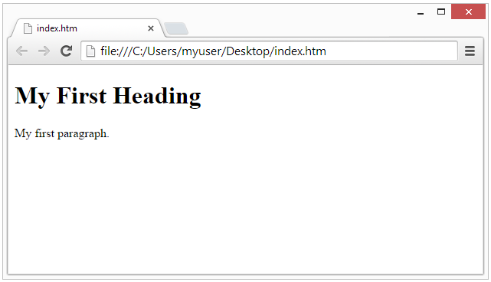
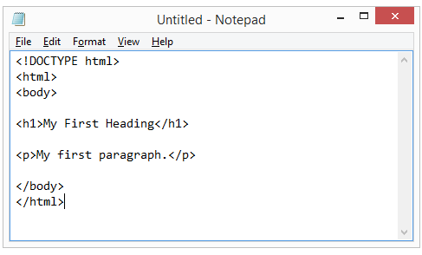

HTML Editor

Slide 12
Content vs. Structure
Content:
The most important part of any website regardless of media type.
“Semantic” approach to design: organizing your content by its meaning instead of by how you want it to look
Structure:
How you want to present the material
CSS (Cascading Style Sheets): format the information the way we want it to appear

Slide 13
Course Content: CSS
CSS stands for Cascading Style Sheets.
CSS allows you to apply more fine-grained control of the format, layout and style of your web pages.
For instance, you can change the font, the size of the font, the color and variations of the font of a word or sentence.
You can anchor text or images to an exact location on the page or allow them to "float" on the page as the user scrolls through content.
Combined with JavaScript (a programming language), you can create "rollover" effects like drop-down menus or changing images.
You can supply multiple style sheets for one web document so that it looks one way by default, you can allow the user to select an optional view and you can provide a style sheet for changing the content's layout if the user prints it to a printer.

Slide 14
Course Content: Perl
JavaScript is a programming language.
A programming language allows you to create a set of instructions that tell the computer what to do or how to respond to certain types of data or situations.
JavaScript runs on the client, not on the server! (at least for this class)
As such, the JS code is downloaded to the browser and then executed.

Slide 15
The Next Step
Some related topics (partially) covered in this class:
Web 2.0 (AJAX, JavaScript / DOM)‏
Setting up and configuring web servers
Some related topics that are not covered in this class:
Flash media development
Web scraping / crawling / robots
Connecting databases to web sites
Server side programming of any kind

